Slide 1

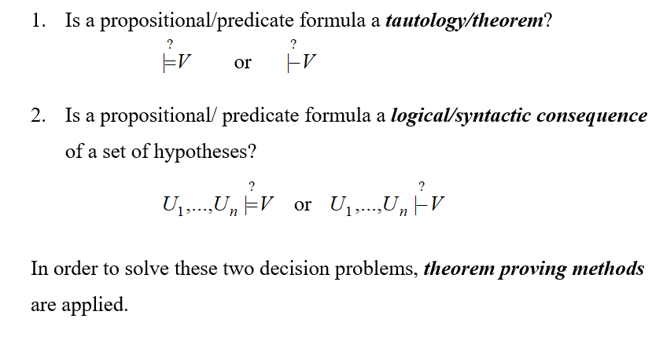
DECISION PROBLEMS IN PROPOSITIONAL/PREDICATE LOGIC

Slide 2
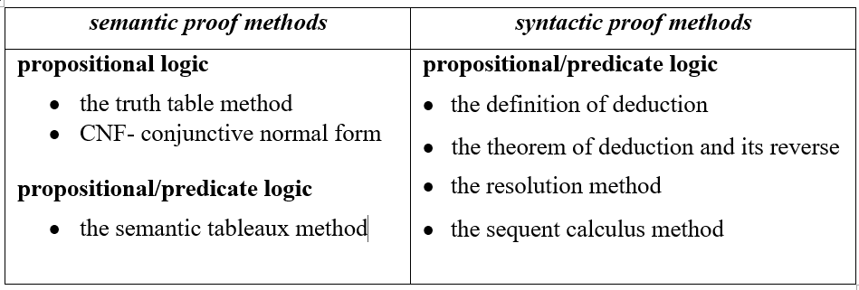
Classification: semantic versus syntactic proof methods

Slide 3
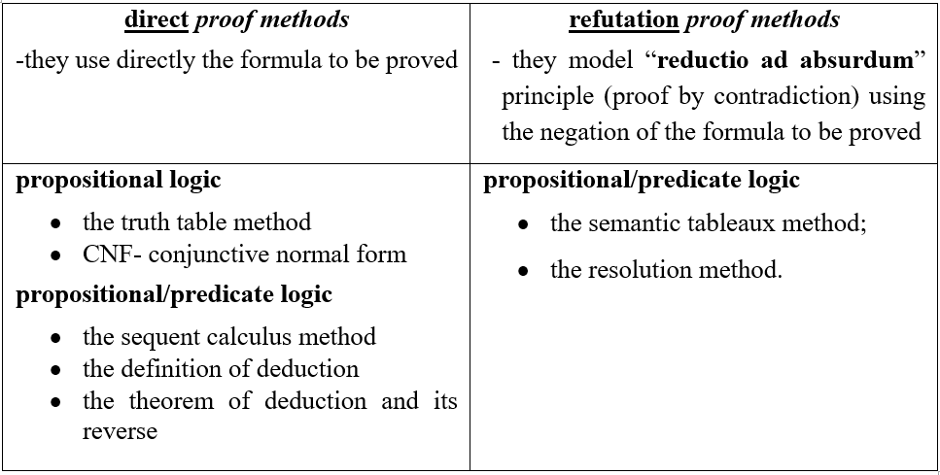
Classification: direct versus refutation proof methods

Slide 4
Semantic Tableaux Method
It was proposed as a proof method for classical logics by
R. Smullyan in 1968.
Dedicated theorem provers: 3TAP, pTAP, leanTAP, Cassandra.
It was easily adapted to nonstandard logics (modal, temporal, many-valued, non-monotonic).
It is based on semantic considerations => semantic method.
Its basic aim is to decide consistency and to find all the models of a formula by decomposing the formula in sub-formulas.
The validity of a formula is proved by contradiction=>
=> refutation method.

Slide 5
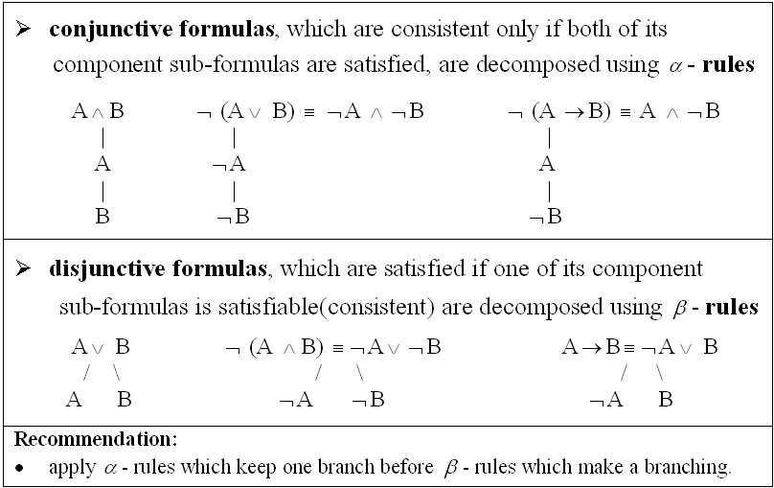
Decomposition rules for propositional formulas

Slide 6
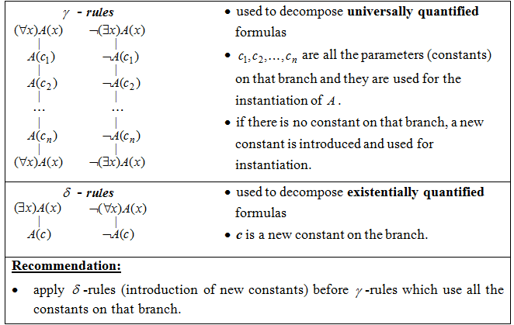
Decomposition rules for predicate formulas

Slide 7
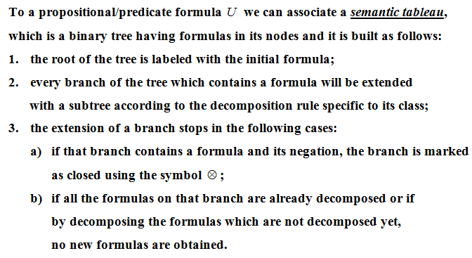
Construction of a semantic tableau

Slide 8
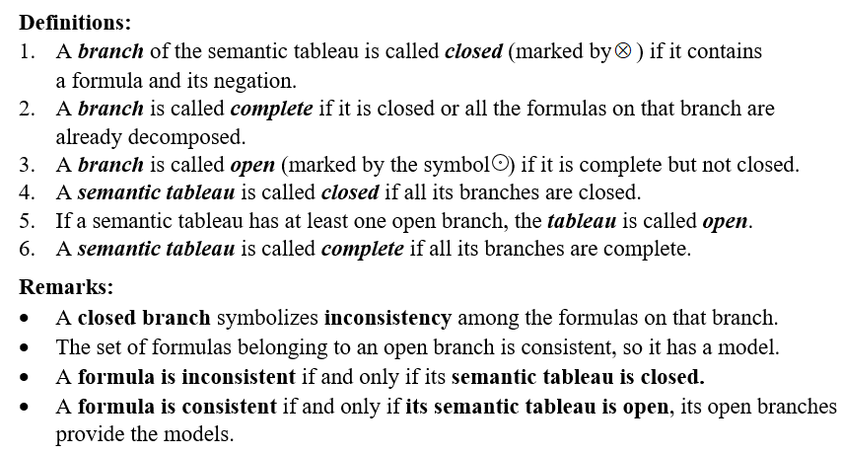
Definitions

Slide 9
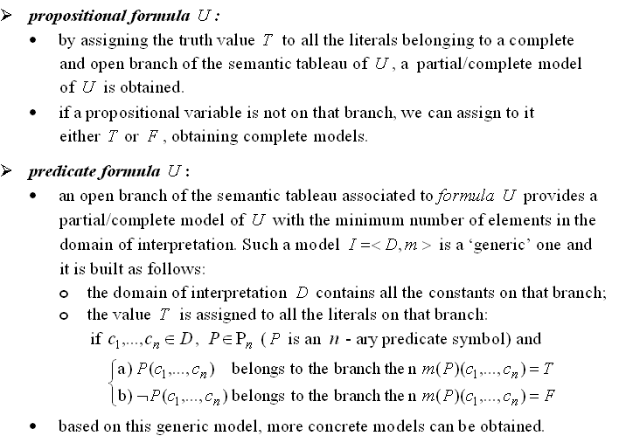
Models of a formula

Slide 10
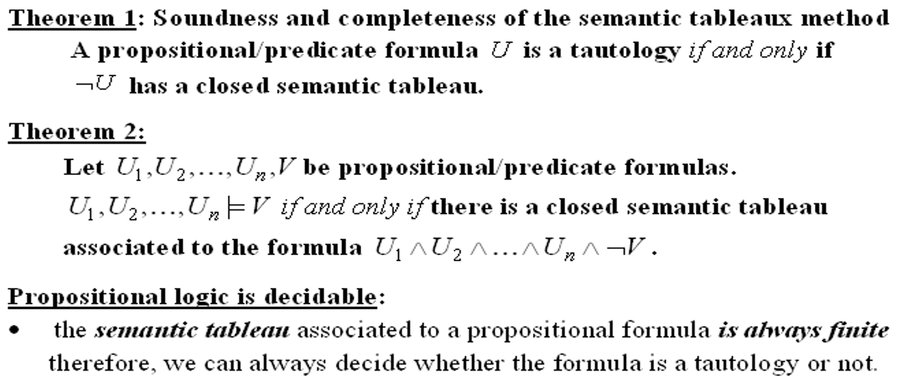
Theorems Semantic tableaux method – a refutation proof method

Slide 11
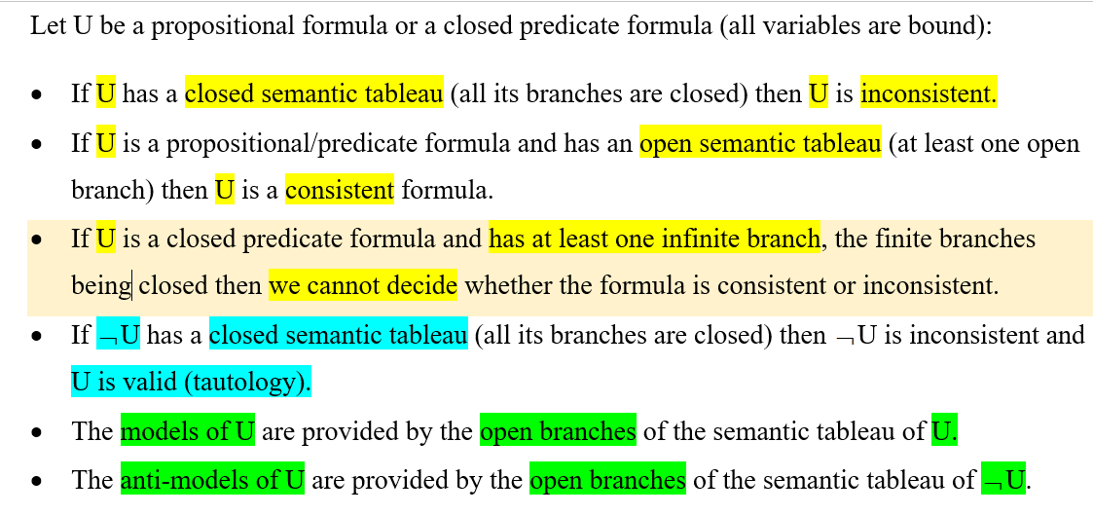
Theoretical results

Slide 12
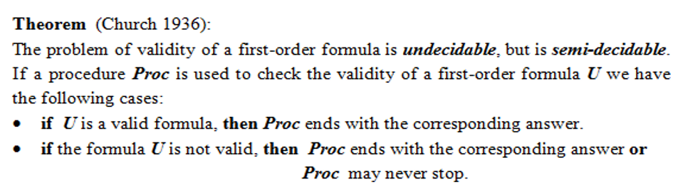
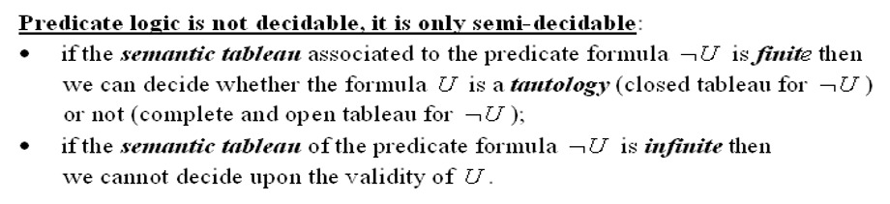
Predicate logic - undecidable

Slide 13

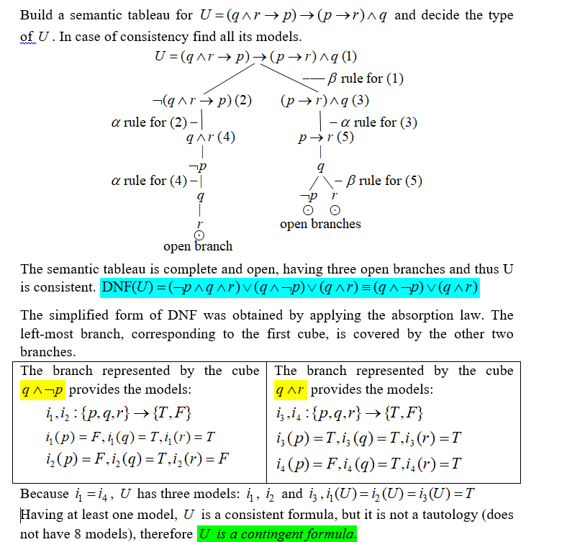

Slide 14
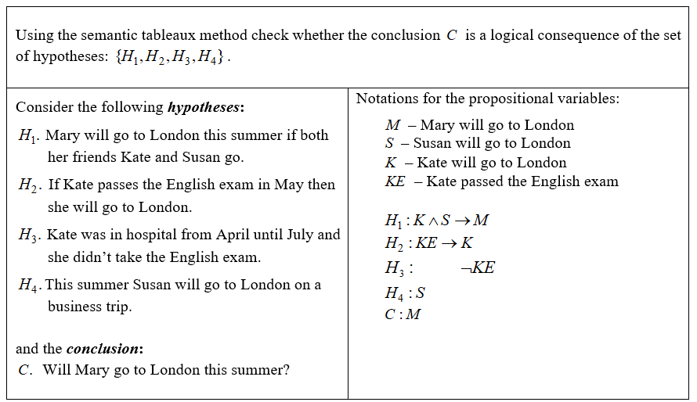
Example 2

Slide 15
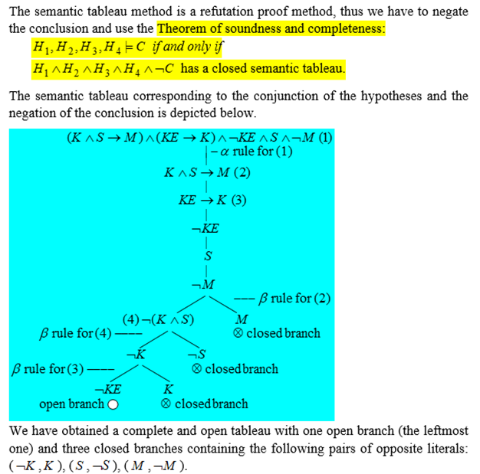

Slide 16
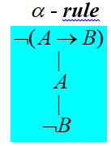


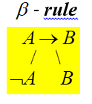



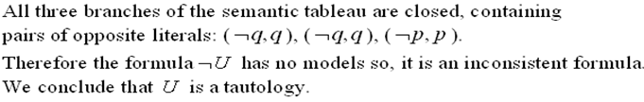
Example 3. Prove the validity of

Slide 17
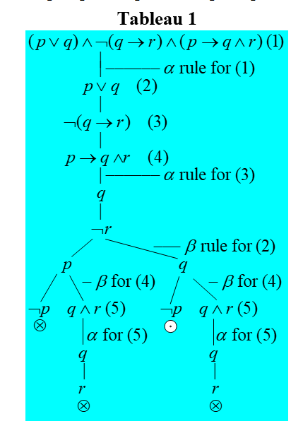
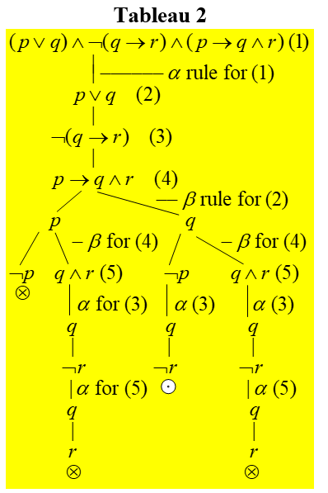
Example 4. Build two different semantic tableaux for the formula:

Slide 18
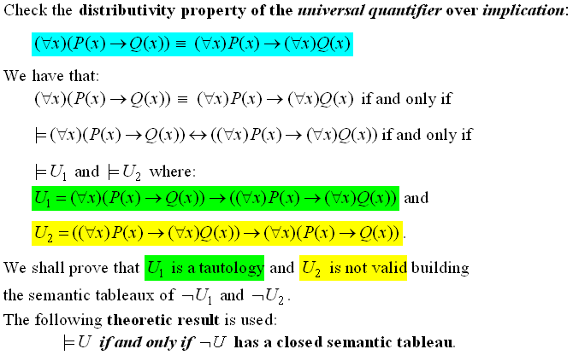
Example 5:

Slide 19
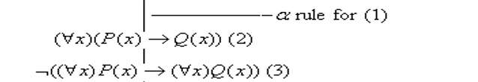

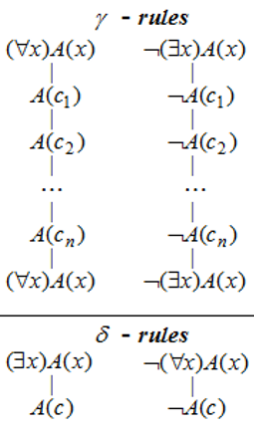

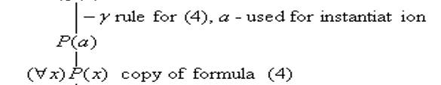
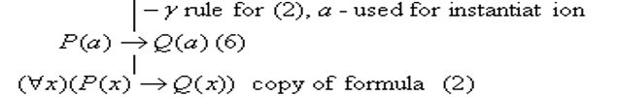
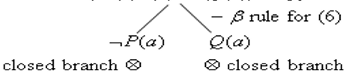


Slide 20

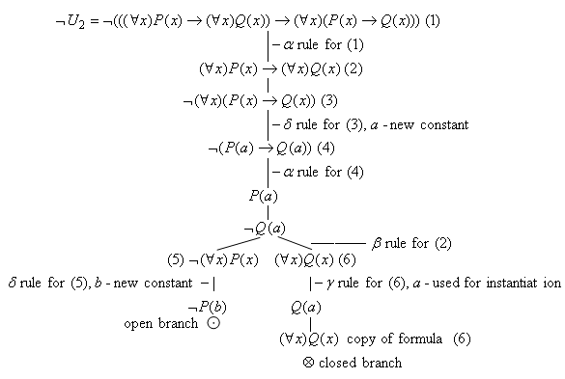

Slide 21

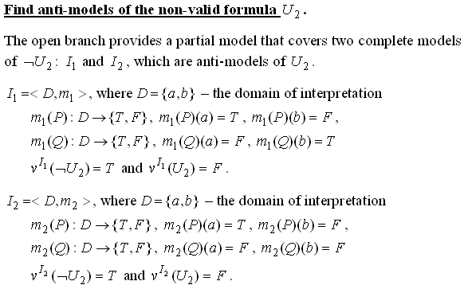

Slide 22
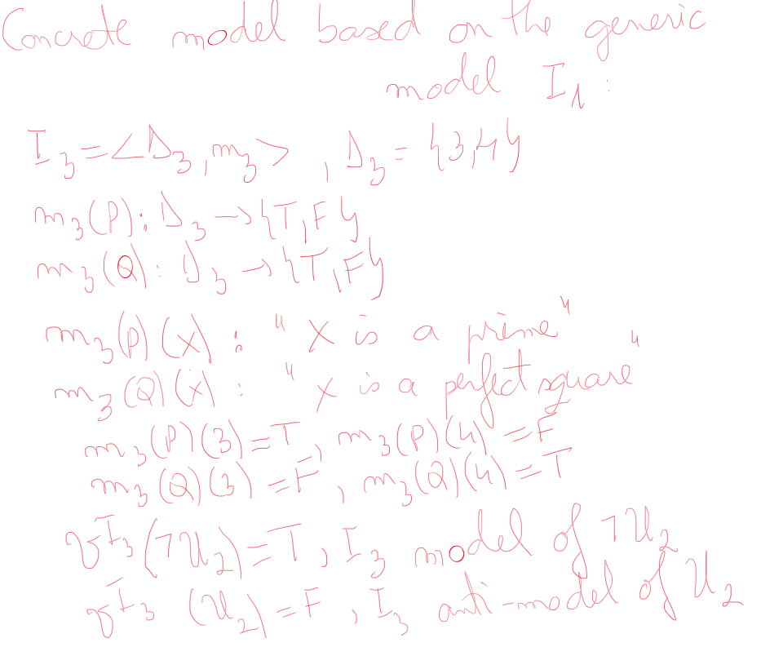

Slide 23

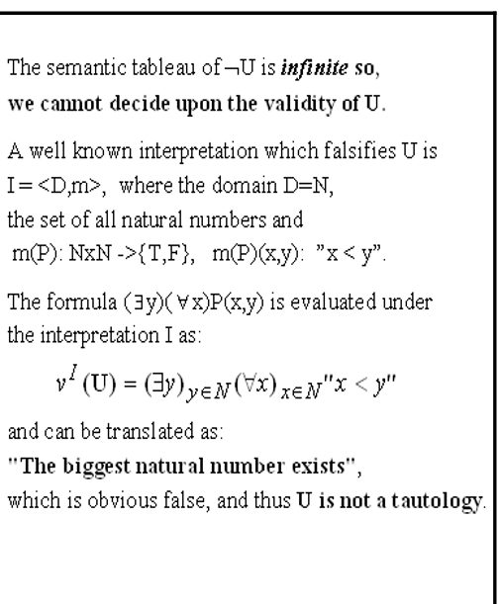
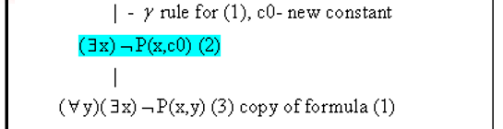

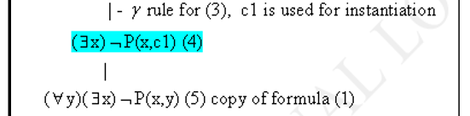

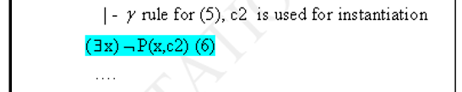
Example 6: Prove the non-validity of

Slide 24

Famous Aristotle Quotes

Slide 25
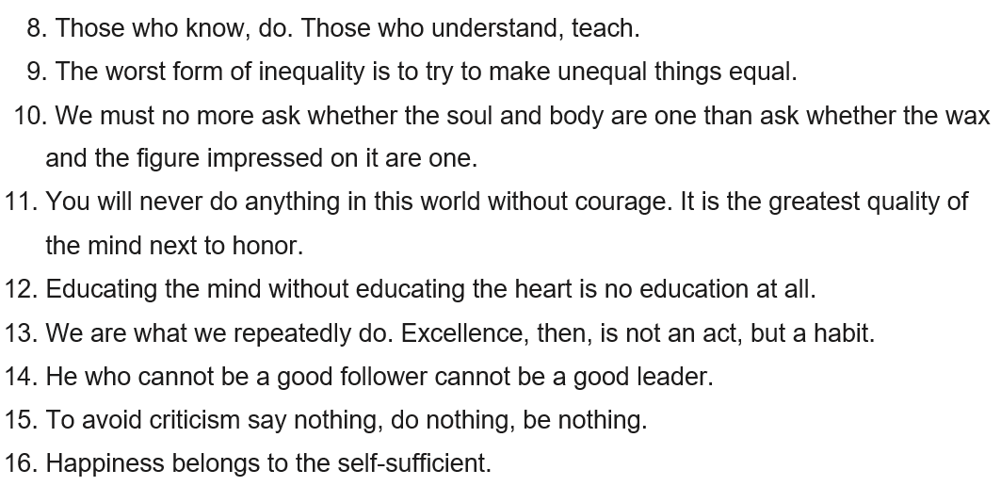
Famous Aristotle Quotes

